Slide 1
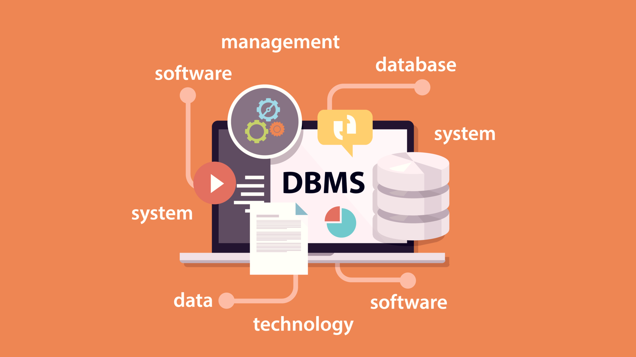

Data Management System
IMAGE TO TEXT CONVERTER
Presenter name

Slide 2
TEAM MEMBERS
BY
2110030209 Allu Jyothi Swaroop
2110030256 R. Satya Sai
2110030217 G. Sri Vardhan Reddy
2110030307 CH. Dileep Reddy
UNDER THE GUIDENCE OF
Dr.SUMIT HAZRA(Asst. Professor)

Slide 3

PROBLEM STATEMENT AND DOMAIN
Online Image to Text converter is proposed here which allows to convert any Text-image to Text.
We are using OCR (Optical Character Recognition) technology used in AI.
An Image is the gathering of the purposefully amassed pixels and the data, presented on an Image, can’t be changed.
The proposed system shows an user interface and update the text with given images.

Slide 4
EXISITING SOLUTIONS
OCR (Optical Character Recognition) is a piece of software that converts printed text and images into digitized form such that it can be manipulated by machine, i.e., image to text.
This technology is used in python IDE and recognizes the image uploaded by the user and develops text format.
Using TerraER software, we have created an ER diagram for the project to give an information of the entities and attributes.

Slide 5
PROPOSED ALGORITHM DESIGN TECHNIQUE
The main objective of Image to text converter is when the user uploads the image, the OCR used in python IDE will scan and recognize the image.
The recognized text is then printed in the console as output and stored in a file for later access.
Using TerraER software, we have created an ER diagram for the project to give an information of the entities and attributes.

Slide 6
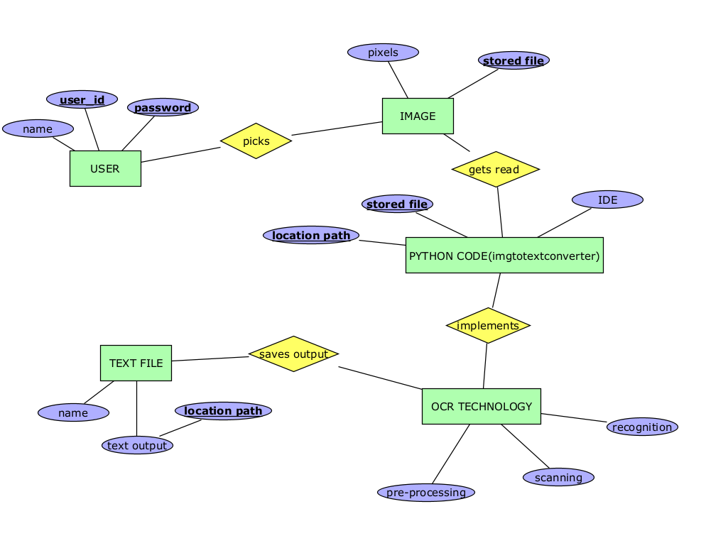
ER DIAGRAM

Slide 7

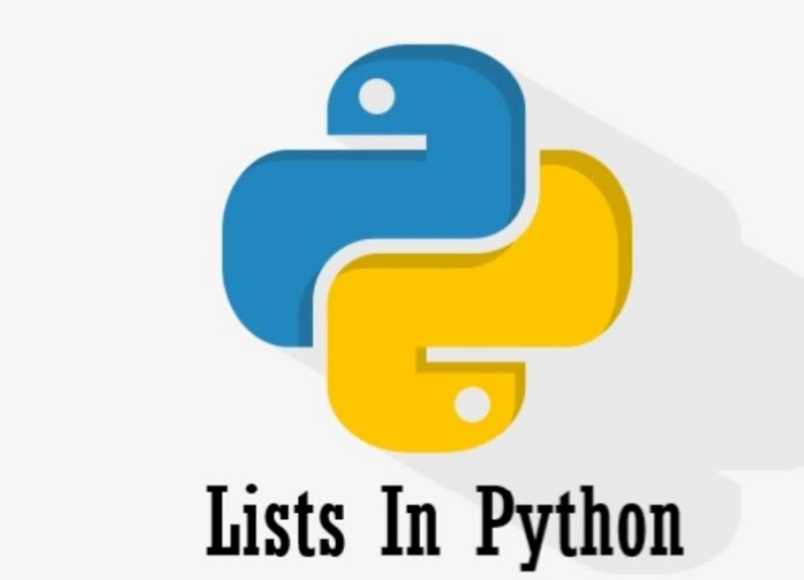
DATA STRUCTURES NEEDED
TerraER
List
Pytesseract and open-cv libraries

Slide 8
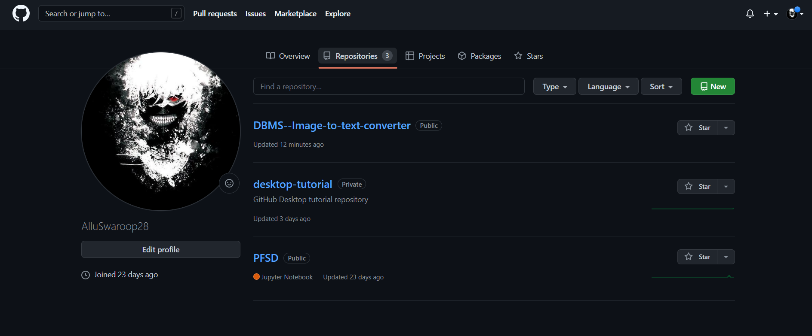

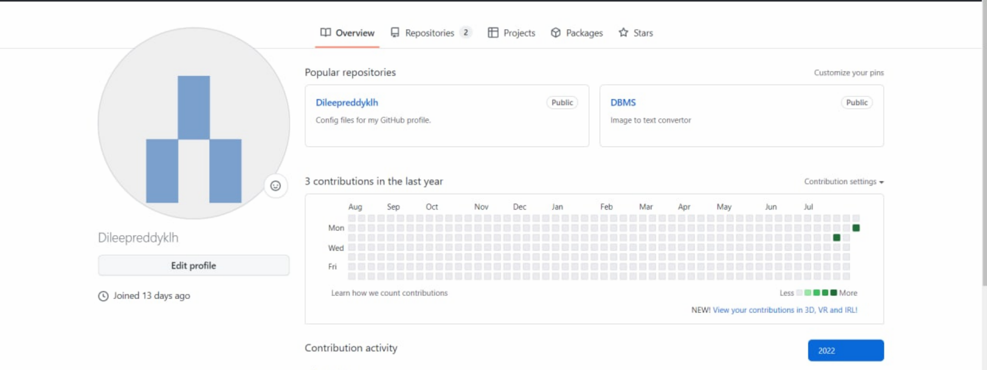
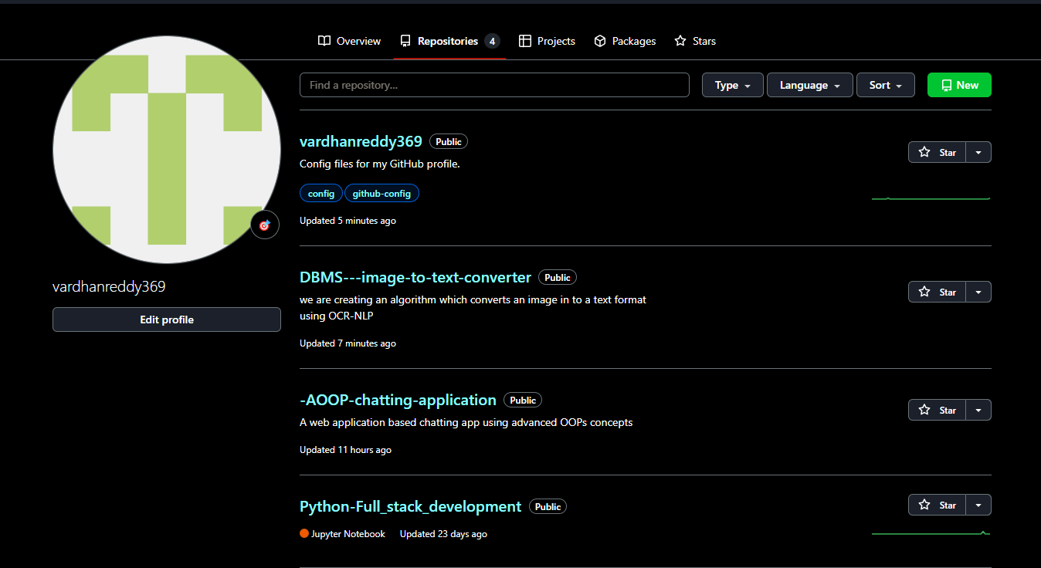
GITHUB SETUP

Slide 9
DIVISION OF WORK AMONG GROUP MEMBERS
Problem Statement: CH. Dileep Reddy
ER Diagram : R. Satya Sai
Proposed Algorithm: Allu Jyothi Swaroop
Existing Solutions and data structures needed : G. Sri Vardhan Reddy

Slide 10


